Slide 1
Graduate School in Psychology
Psychological Science Diversity Committee
April 15, 2022

Slide 2
Overview
Types of graduate programs
Introduce panelists
Overview of application process for MA vs PhD programs
What you can do to prepare for graduate school in Psychology
Resources

Slide 3
Types of Graduate Programs
Therapy only
Counseling Master’s Program (e.g., Marriage & Family, Applied Behavioral Analysis)
Therapy & Research
School Psychology PhD
Experimental Psychology PhD or Neuroscience PhD
Research only
Clinical Psychology PhD
Counseling Psychology PhD

Slide 4
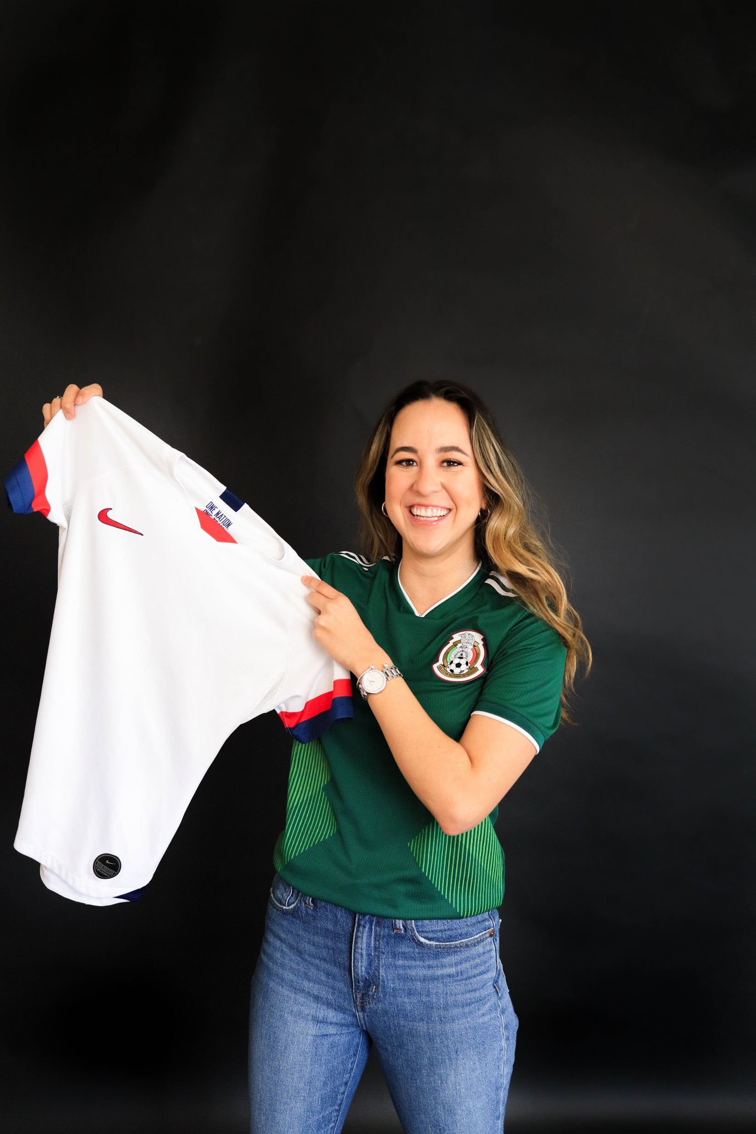
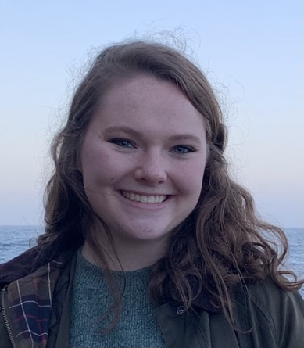
Roselee Ledesma (she/her)
5th year Clinical Psychology PhD student
Undergrad major: Psychology minors: Spanish & Criminal and Law Studies
Myrna Olaya (she/her)
Clinical Mental Health Counseling master’s student, will start Ph.D. in Marriage and Family therapy this fall
Undergrad major: Psychology minor: human developmental family sciences
Morgan Wilson (she/her)
1st year Experimental Clinical Psychology PhD student
Undergrad majors: Biochemistry & Psychology
Ishan Vengurlekar (he/his)
Will start PhD in School Psychology this fall
Undergrad major: Psychology minor: Social Work

Slide 5
Questions for the Panel
How did you decide to pursue graduate school in Psychology?
Why did you choose this graduate program?
What do you hope to do with this training (e.g., career)?
Notes:
Intros
How did you decide on this grad program, what do you hope to do with this training?

Slide 6
Overview of Application Process (Master’s programs)
Find graduate programs to apply to
Most applications are due in the Spring (some have rolling admissions)
What you need to submit:
Personal statement
Letters of recommendation (usually 3)
Curriculum Vitae (CV) (some schools ask for a resume)
Transcripts
Graduate Record Examination (GRE) - $205 (some schools are no longer requiring the GRE)
On test day you can send it to 4 schools for free, $27 to send to each school
Some schools require GRE Subject Test - $150
Application fee (ranges about $50 - $100. You may be able to get it waived)
Notes:
You apply to a program, not just one person

Slide 7
Overview of Application Process (PhD programs)
Find graduate programs to apply to (ask advisors, academic societies)
Most applications are due December 1st (some as early as November 15th)
What you need to submit:
Personal statement and/or research statement
Diversity statement (some schools require this; others may ask you to address how your experiences and/or interests contribute to diversity in their program in your personal statement)
Letters of recommendation – usually 3
Curriculum Vitae (CV) (some schools ask for a resume)
Transcripts
Graduate Record Examination (GRE) - $205 (some schools are no longer requiring the GRE)
Writing sample (some schools require this)
Application fee (ranges about $50 - $100. You may be able to get it waived)
Intangibles – networking, reaching out to potential advisors
Notes:
On test day you can send it to 4 schools for free, $27 to send to each school
Some schools require GRE Subject Test - $150
You’re applying to a mentor – one person

Slide 8
Timeline
Fall – 3 years before starting Graduate School | Fall – 2 years before starting Graduate School | Summer – 1 year before starting Graduate School | Fall – 1 year before starting Graduate School | Spring – Year you plan to start Graduate School | Fall – Starting Graduate School
Participate in research and/or clinical opportunities (research labs, volunteering, working for a suicide help line) Find mentors (faculty and grad students) | Try to present your work at research conferences /publish your work (submission deadlines are half-year before actual) | Find programs to apply to Draft personal statement Take the GRE Ask for letters of rec | Reach out to potential grad advisors Send transcripts and GRE scores to schools Submit before deadline (November 15th, December 1st) | Interview for programs If you get offers, you need to make a decision by April 15th | Start graduate school (August)

Slide 9
What can I do to prepare?
Self Reflection!
What do you like about psychology? → Will help for your personal statement
Do you want to provide therapy? Do you want to conduct research? Both? → help you choose a program
Take classes about topics you’re interested in (even outside psych; technical) → identify your interests and develop skills
Work with professors→ You will need strong letters of recommendation (grad students and/or faculty)
Participate during class, Attend office hours
Join their research lab

Slide 10
What can I do to prepare?
Gain research experience
Join a research lab, present at conferences, seek mentorship from a graduate student → You will learn whether you like research, and gain experience to add to your CV
Volunteer
You will learn more about what you want to do and which communities you want to work with → These may be experiences you write about in your personal statement
For master’s programs, it is important to volunteer at places like the NWA Center for Sexual Assault, 7hills, etc. because experience working with people is very important
Consider gap year(s)
Work full-time in research lab (perspective on whether you like research, presentations, letters of rec)

Slide 11
Questions for the Panel
What do you wish you had started doing as an undergrad to prepare you for graduate school in psychology?
What is something you wish you would known about graduate school before you applied?
What advice would you give to someone who is thinking about applying to graduate school in Psychology?
Notes:
Intros
How did you decide on this grad program, what do you hope to do with this training?

Slide 12
Resources
Websites
https://www.apa.org/education-career/grad/applying
Clinical Psych Grad School: Your Guide to Getting In https://clinicalpsychgradschool.org/
Books/articles
What Psychology Majors Could (and Should) Be Doing: An Informal Guide to Research Experience and Professional Skills by Paul J. Silva, Peter F. Delaney, and Stuart Marcovitch
Insider’s Guide to Graduate Programs in Clinical and Counseling Psychology by John C. Norcross and Michael Sayette
Lists a timeline for the application process, lists all APA-accredited clinical and counseling PhD programs by research area!
Appleby, D.C., & Abbleby, K.M. (2006). Kisses of death in the graduate school application process. https://psychology.unl.edu/psichi/Graduate_School_Application_Kisses_of_Death.pdf
Videos
Getting into Psych Grad School During the Time of COVID (https://www.youtube.com/watch?v=f-5DjLRKCHQ&t=1203s)
Learn about the application process
Getting into Psych Grad School – A Panel for BIPOC students (https://www.youtube.com/watch?v=DcC9GrWeamk)
Learn about the experiences of Black graduate students and professionals in psychology
Volunteer opportunities
https://volunteer.uark.edu/

